Slide 1
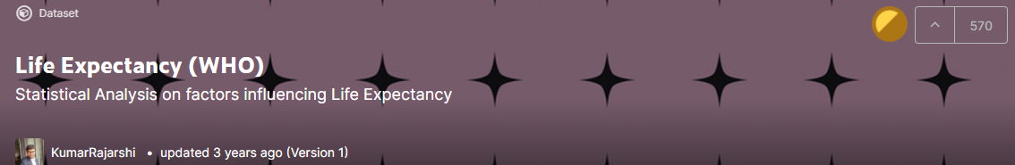

Regression Project
Linoy Elias
Roni Shternberg
Link to Project

Slide 2
Problem Statement
The problem: To predict life expectancy for countries around the world
The data set: Taken from Kaggle
Contains information compiled by the World Health Organization (WHO) and the United Nations to track factors that affect life expectancy
Sits at an optimal size between being too toyish and too cumbersome
The data contains 2938 rows and 22 columns (which are not self-explanatory)
Each row represents a country and a year combination
20 numeric columns and 2 categorical columns (country and developing status)

Slide 3
Knowledge Data (1)
Columns - Features (independent variables):
Immunization factors, mortality factors, economic factors, social factors and other health related factors.
Country: There are 193 unique countries
Year: 2000-2015
Status: "Developed“ or "Developing“
Adult Mortality: Rates of both sexes (proba. of dying between 15-60 years per 1000 population)
Infant deaths: Num. per 1000 population
Alcohol: consumption per capita (15+) (in liters of pure alcohol)
Pct. expenditure: Country’s expenditure on health - as a pct. of Gross Domestic Product (GDP) per capita(%)
Tot. expenditure: General government expenditure on health as a pct. of tot. government expenditure (%)
BMI: Avg. Body Mass Index of entire population
Immunization coverage (among 1-year-olds (%)): Hepatitis B, Polio, Diphtheria

Slide 4
Knowledge Data (2)
Measles: Num. of reported cases per 1000 population
Under-five deaths: Num. of deaths under 5-years-old per 1000 population
HIV/AIDS: Deaths per 1000 live births HIV/AIDS (0-4 years)
GDP: Gross Domestic Product per capita (in USD)
Population
Thinness 5-9 years: Prevalence of thinness among children for Age 5 to 9 (%)
Thinness 10-19 years: Prevalence of thinness among children and adolescents for Age 10 to 19 (%)
Income composition of resources: Human Development Index in terms of income composition of resources (index ranging from 0 to 1)
Schooling: Num. of years of Schooling
Target variable (dependent variable):
Life expectancy: Mean: 69.23, Std: 9.5, Min: 36.3, Median: 72.1, Max: 89.0

Slide 5
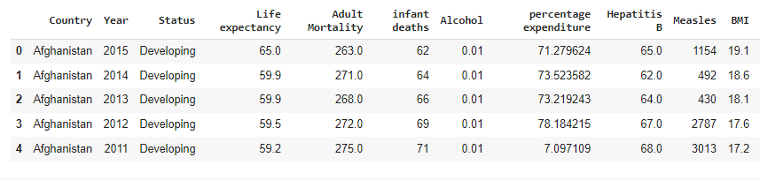
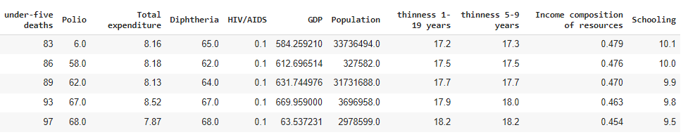
Looking at the Data
Continue…

Slide 6
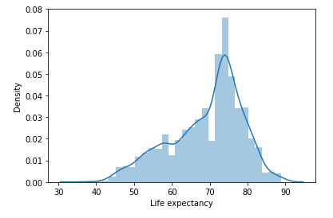
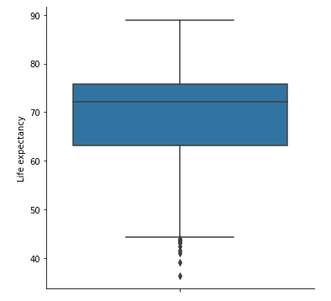
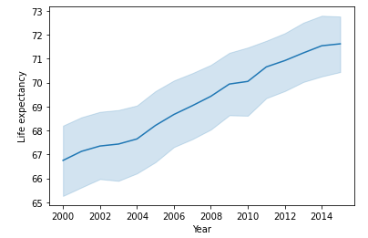
Target Variable Distribution - Life Expectancy
Mean: 69.23, Std: 9.5, Min: 36.3, Median: 72.1, Max: 89.0

Slide 7
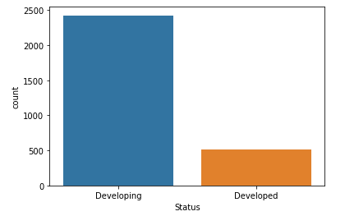
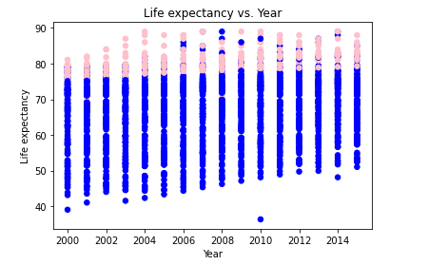
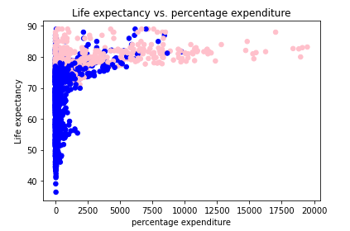
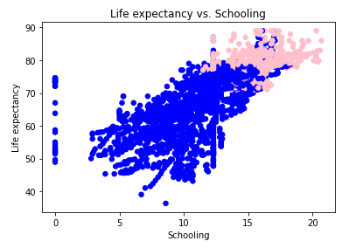
Exploratory Data Analysis (EDA)
Cleaning & fixing column names
There are no duplicate rows
Status: "Developed“: 17%, "Developing“: 83%
Handling missing values
Missing cells: 2563 (4.0%)
Removing rows will have dropped ~44% of the rows
Therefore, we impute columns with median value
Blue = developing countries, Pink = developed countries

Slide 8
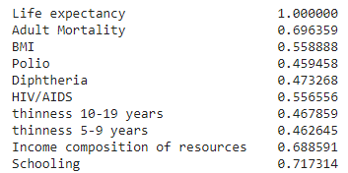
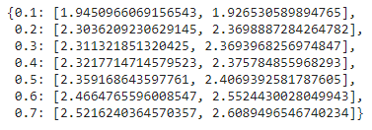
Feature Selection - Correlation Matrix (1)
Used 5 techniques:
1. Pearson’s Correlation Matrix + running linear regression model in a loop with different thresholds towards target variable (threshold = 0 → use all features)
Example: columns with threshold of > 0.45 with target variable:
Results:
threshold value:{train_rmse,test_rmse}
Conclusion: the best prediction was made with all features used

Slide 9
Feature Selection - Correlation Matrix (2)
2. Pearson’s Correlation Matrix :
Dropping one variable of each pair of variables that are highly correlated to each other
Leaving the variable that has a stronger correlation with target variable
HIV/AIDS and Adult Mortality (0.52) → HIP/AIDS was dropped
BMI and Income composition of resources (0.51) → BMI was dropped
Income composition of resources and Schooling (0.8) → Income composition of resources was dropped
Polio and Diphtheria (0.67) → Polio was dropped
thinness 5-9 years and thinness 10-19 years (0.94) → thinness 5-9 years was dropped
Train RMSE: 1.99, Test RMSE: 1.99
Conclusion: dropping highly-correlated columns hasn’t improved the prediction result (1.93 vs 1.99)

Slide 10
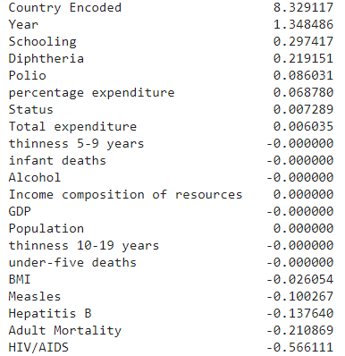
Feature Selection - Lasso
3. Lasso regression
Purpose: to see the features coefficients and drop all the features with close to 0 coefficients.
Eliminated (model_coef == 0): 8 variables:
Train RMSE: 1.95, Test RMSE: 1.92

Slide 11
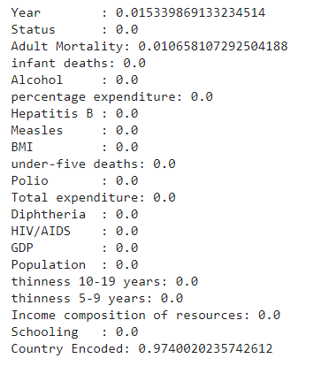
Feature Selection - Decision Tree - Feature Importance
4. Feature Importance

Slide 12
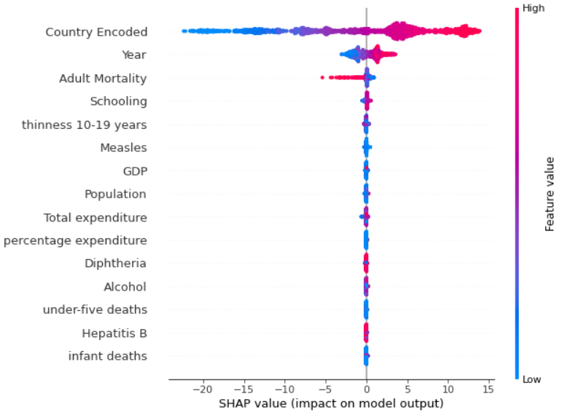
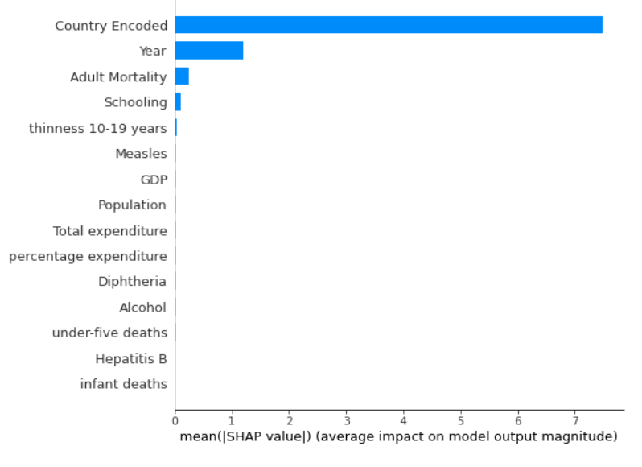
Feature Selection - SHAP Values (1)
5. SHAP values (SHapley Additive exPlanations) is a unified approach to explain the output of any machine learning model.
https://towardsdatascience.com/explain-your-model-with-the-shap-values-bc36aac4de3d

Slide 13
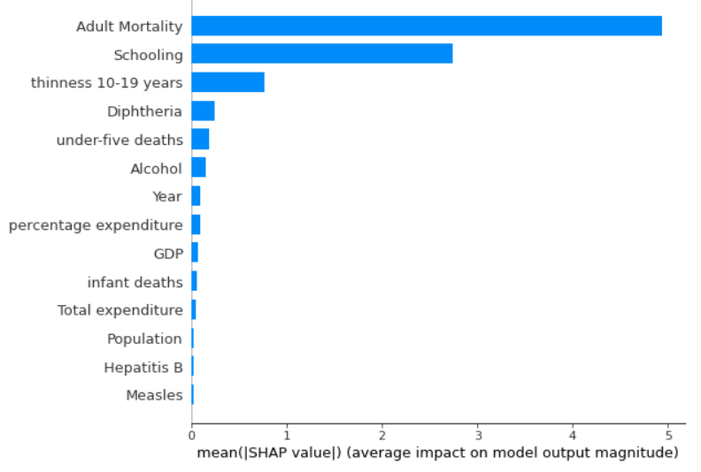
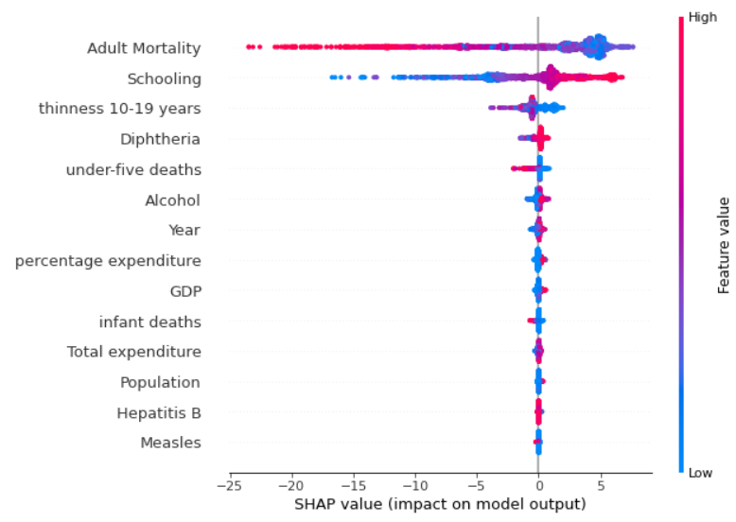
Feature Selection - SHAP Values (2)
SHAP values - when we drop ‘Country’ column without encoding it to ‘Country Encoded’:

Slide 14
Preparing Data for Models
Encoding categorical features
Status: ‘Developing’: 0, ‘Developed’: 1
Country: Target Encoding - as ‘Country Encoded’ column
Regarding Country:
When dropping Country - the model results were significantly worse
Tried the additive smoothing approach (“smooth” the average by including the overall average) - didn't achieve significant difference
Thoughts to combine Country into sub-groups (by social-economic index or by continents for example)

Slide 15
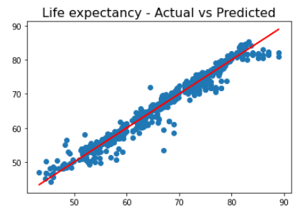
Models and Results - Linear Regression
Scaling the data using StandardScaler
Train RMSE: 1.94 (Root Mean Squared Error)
Test RMSE: 1.93

Slide 16
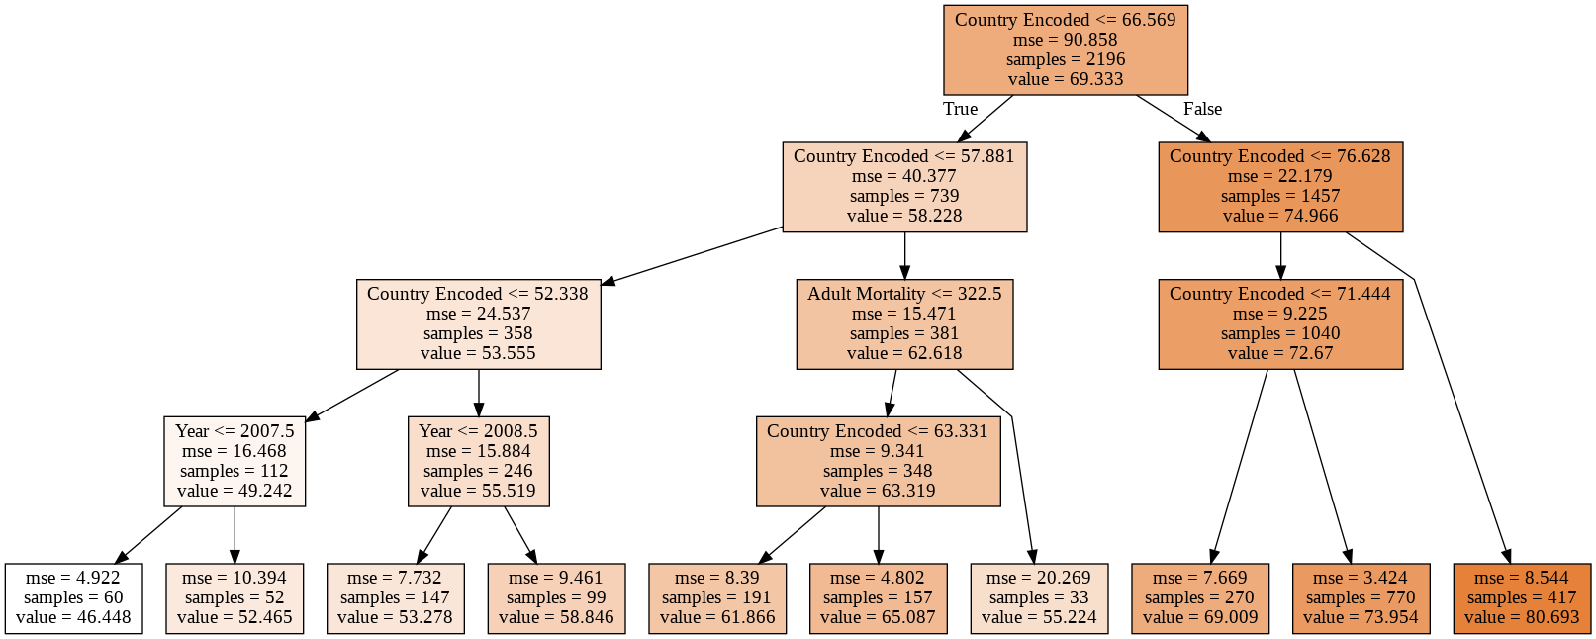
Models and Results - Decision Tree
max_leaf_nodes = 10
Train RMSE: 2.54, Test RMSE: 2.67
Feature importance:
Country Encoded: 0.974, Year : 0.015, Adult Mortality: 0.011

Slide 17
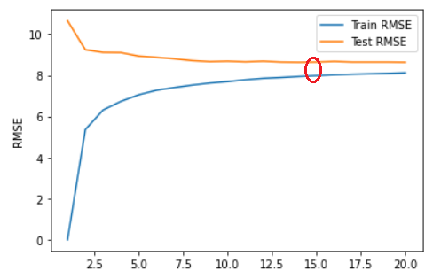
Models and Results - KNN
We ran KNN model with different number of neighbors (1 to 20) and compared the RMSE results. Best results:
n_neighbors=14
Train RMSE: 7.94
Test RMSE: 8.63

Slide 18
Models and Results - Random Forest
Grid Search with Decision Tree Regressor
With 5-fold cross-validation
Random Forest:
n_estimators=700 (default: 100)
max_depth=7
min_samples_leaf=5
min_samples_split=10
Train RMSE: 1.34
Test RMSE: 1.63

Slide 19
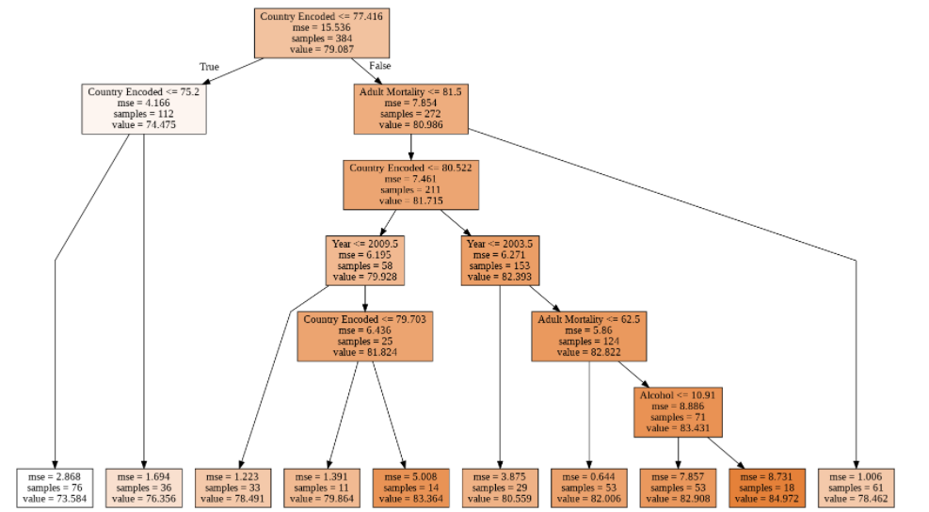
Run models for Developed Countries
We separated the dataset into 2 datasets - one for developing countries, and one for developed countries
Run all models on the developed countries
The LassoCV Model Eliminated 16 of the 20 variables
Keeping ‘Country Encoded’, ‘Year’, ‘Schooling’ and ‘Diphtheria’
The DT looks completely different (e.g: ‘Alcohol’)
KNN gives much better results

Slide 20
Comparison and Conclusions
Models (Full Dataset) | Train RMSE | Test RMSE
Linear Regression (base model) | 1.94 | 1.93
Decision Tree Regressor | 2.54 | 2.67
K-Nearest Neighbors Regressor | 7.93 | 8.63
Random Forest Regressor | 1.33 | 1.64
Models (Developed Dataset) | Train RMSE | Test RMSE
Linear Regression | 1.84 | 2.04
Decision Tree Regressor | 1.76 | 2.17
K-Nearest Neighbors Regressor | 2.73 | 3.20
Random Forest Regressor | 1.21 | 1.80

Slide 21
Further Thoughts
Outlier detection and removal
Replace missing values in more sophisticated manner
Run other algorithms for feature selection - like "Select K-best"
Feature engineering:
Create new columns using the mix of the most important columns
Aggregate Country column into groups (by social-economic index or by continents for example)

